Slide 1






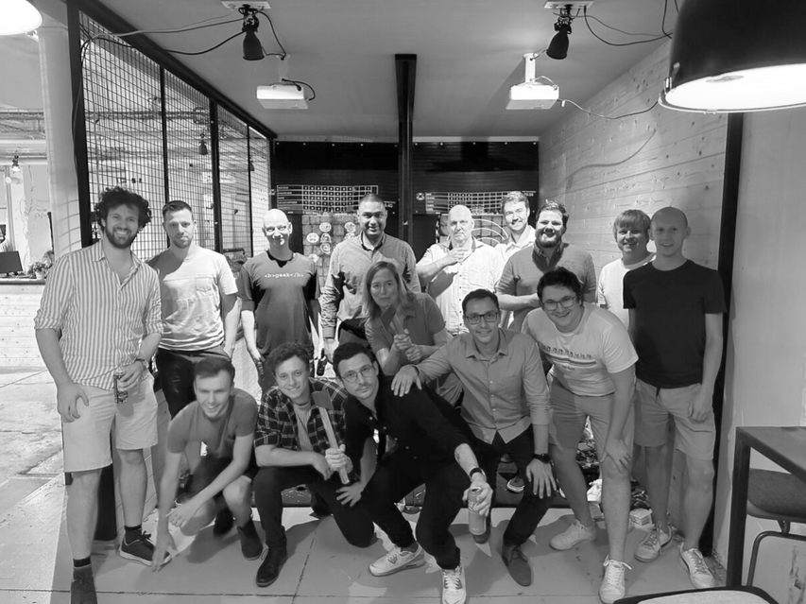

React Component Profiling
Notes:
Hello everyone, I’m Wouter Van Schandevijl, CTO at itenium, a company founded by consultants, for consultants.
We’re a Belgian IT Consultancy with a strong focus on improving ourselves while doing what we love.
React Component Profiling is an extract of a workshop in our Frontend Track.

Slide 2




Menu
React Profiler
UseCase confac (in-memory)
InvoiceList
projectMonths
Alternatives
Notes:
confac: The DB is loaded into the Redux store!

Slide 3



React Profiler
Included in the React Developer Tools
⚛️ Profiler Tab

Slide 4








Profiler Buttons
Start profiling
Stop profiling
Reload page and start profiling
Prev / next commit

Slide 5



Profiler Displays
Flamegraph
Ranked

Slide 6




confac - InvoiceList
6s
Easy Pickings

Slide 7
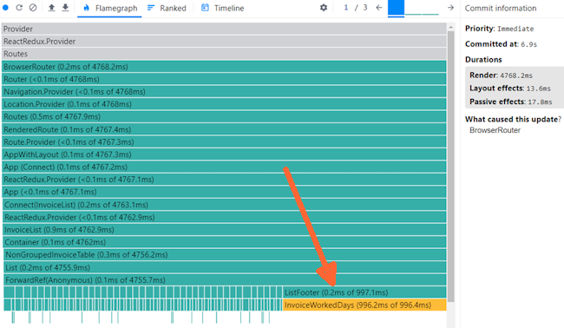
confac - InvoiceList
6s
Notes:
Profiler Page Reload Flamegraph
6s for 100 rows.

Slide 8

confac - InvoiceList
Performance Bottlenecks…
It’s almost always something unexpected
Notes:
What is the InvoiceWorkedDays?

Slide 9
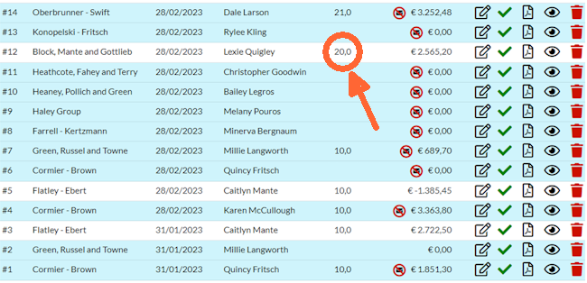
confac - InvoiceList
6s

Slide 10


The Bottlenecks
Third Party Package (date-holidays)
Nested Loops (CPU)
Frequent IO (sessionStorage)
6s → 360ms
Notes:
3 runs of the profiler – the flamegraph indicated a clear performance target
Third Party Package
date-holidays is very small but astronomia etc → 10MB footprint
To calculate the amount of Belgian holidays in a given month
Nested Loops:
For all projects, map to a FullProjectMonth (6 inner loops to get the Consultant, Client, Project etc details)
And then filter one on object.id.
Frequent IO:
Basically every icon, button & link is wrapped with WithClaim which accessed sessionStorage and parsed the JWT token to figure out the roles of the user.

Slide 11


confac - projectMonths
5s
The Meaty Part
Notes:
⏱️ 2 open projectMonths: 350ms
⏱️ 4 open projectMonths: 1.2s
⏱️ 18 open projectMonths: 5s
For 18 months & 718 projects

Slide 12
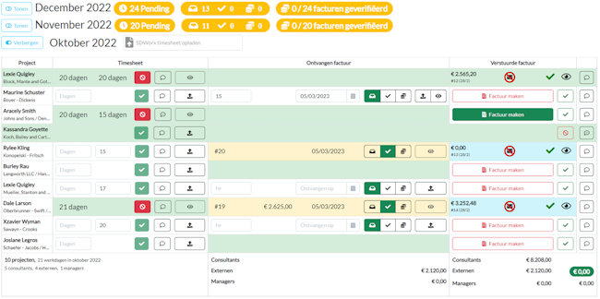
confac - projectMonths
5s

Slide 13
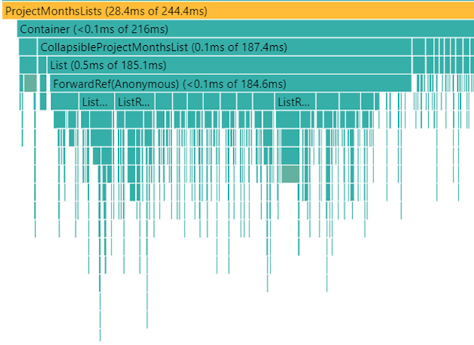
confac - projectMonths
5s
Notes:
No clear performance target!

Slide 14

confac - projectMonths
Everything is re-rendered when opening/collapsing a projectMonth
Rendering a collapsed projectMonth does expensive IFeature calculation
Notes:
Also the Redux Store: opened months were a string[] and the array was passed to the Component
Only depend on a Boolean!

Slide 15

IFeature Caching
Introducing reselect
import { createSelector } from 'reselect';
const createFullProjectMonthsSelector = () => createSelector(
// Select required store data
(state: ConfacState) => state.projects,
(state: ConfacState) => state.consultants,
// Introduce a "month" parameter for the selector
(_, month: string) => month,
// The expensive calculation
(projects, consultants, month) => projects.map(createMapper(month, consultants)) );
Notes:
reselect:
A library for creating memoized "selector" functions. Commonly used with Redux.
Comes with @reduxjs/toolkit
Memoize:
To store the result of a computation so that it can be subsequently retrieved without repeating the computation.

Slide 16

IFeature Caching
Introducing useMemo
import { useMemo } from 'react';
const OpenedProjectMonthsList = ({ month }) => {
// Use the createSelector as defined in previous slide
// With empty array as dependencies argument
const selectProjectMonths = useMemo(createFullProjectMonthsSelector, []);
// Use the memoized selector
const projectMonths = useSelector(state => selectProjectMonths(state, month));
// And construct the IFeature
return <List feature={projectMonthFeature(projectMonths)} />;
};

Slide 17

CollapsedProjectMonth
Introducing memo
import { memo } from 'react';
// Memoize the component for each value of month
const CollapsedProjectMonthListMemo = memo(({ month }) =>
<CollapsedProjectMonthList month={month} />;
const ProjectMonthList = ({ month }) => {
const isOpen = useSelector(state => state.openMonths[month]);
if (isOpen) return <OpenedProjectMonthList month={month} />;
return <CollapsedProjectMonthListMemo month={month} />;
};

Slide 18

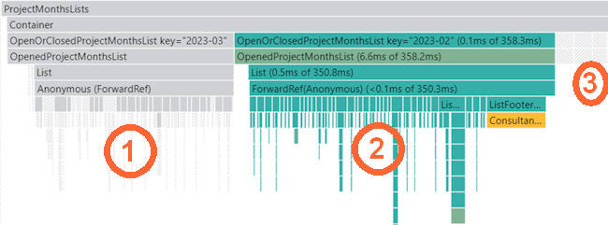
confac - projectMonths
140ms
Opening a second projectMonth
Notes:
⏱️ 2 projectMonths: 350ms -> 170ms
⏱️ 4 projectMonths: 1.2s -> 311ms
⏱️ 18 open projectMonths: 5s -> 140ms

Slide 19

Take-Aways
Depend on as little as possible
Prefer props only for low level components
Cache expensive calculations
Using createSelector and useMemo
Cache entire components with memo

Slide 20




THANK YOU!
Notes:
All the code is available on Github, there is also a blog post on itenium.be

Slide 21

Profiler Alternatives
console.time('t1')
const result = expensiveOp1()
console.timeLog('t1', result)
expensiveOp2()
consoled.timeEnd('t1')

Slide 22

Profiler Alternatives
import { Profiler } from 'react'
const LongRendering = () => (
<Profiler id="id1" onRender={fn}>
<LongRenderingItem />
</Profiler>
)

Slide 23
Micro Optimalizations
Avoid inline styles
useCallback
useWhyDidIUpdate
useDebugValue

Slide 24
Final Take-Away
The IFeature
Weeks of coding can save you hours of planning
-- Fred Brooks

Slide 25
THANK YOU!

Slide 26



15min
React Component Profiling
(confac)
Theoretical
FrontendTrack

